Slide 1
Enterprise Applications
Systems for linking the enterprise
Span functional areas
Execute business processes across the firm
Include all levels of management
Four major applications
  Enterprise systems
  Supply chain management systems
  Customer relationship management systems
  Knowledge management systems
Notes:
Enterprise applications are used to manage the information used in the systems discussed previously. In other words, enterprise applications are used to ensure that TPS, MIS, DSS, and ESS work together smoothly.

Slide 2
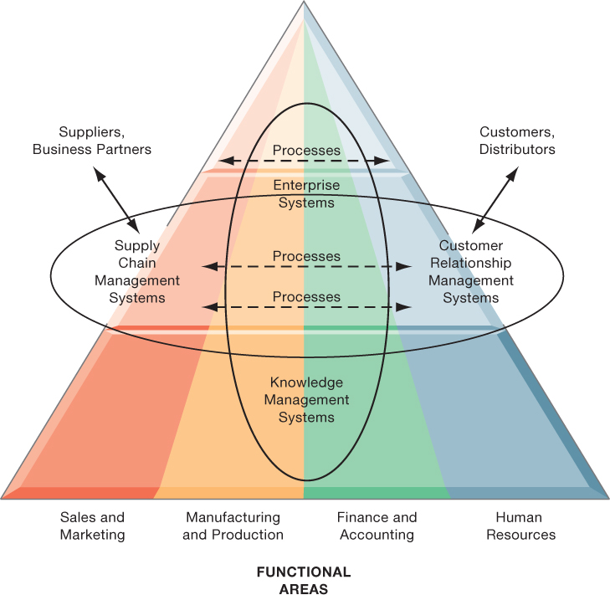
Enterprise Application Architecture
Notes:
Enterprise applications automate processes that span multiple business functions and organizational levels and may extend outside the organization.
The purpose of this graphic is simply to illustrate that enterprise systems are very large and diverse databases that pull information from many parts of the firm and enable processes across the firm at different organizational levels, as well as with suppliers and customers.
The triangle represents the organization, with different colors for the four main business functions. The ovals show that an enterprise application architecture incorporates systems used in sales and marketing, enabling these to communicate with each other and externally, with suppliers and customers. It also incorporates information supplied by knowledge management systems, manufacturing and finance systems, and other enterprise systems. The purpose of incorporating data and information from all of these sources is to enable and automate cross-functional business processes and supply accurate information to aid decision making.

Slide 3
Enterprise Systems
Collect data from various business functions and store it in a centralized repository.
Integrate processes across sales and marketing, manufacturing and production, finance and accounting, and HR into a single software platform.
Eliminate issues caused by fragmented data.
Accelerate the flow of information across the organization.
Enhance flexibility in meeting customer demands and improve accuracy in order fulfillment.
Provide managers with a comprehensive view of overall operations.
Notes:
This slide emphasizes the singularity of enterprise systems (one system) that integrates information flows from a variety of sources and serves a wide variety of groups and purposes in the firm. Remind students of the difference between enterprise applications and enterprise systems: Enterprise applications are any applications that span the enterprise, and types of enterprise applications include CRM, SCM, KMS, and enterprise systems. Enterprise systems refers to the larger database environment within which these applications reside and operate.
Note that enterprise systems are referred to in some first as enterprise resource planning systems (ERP).

Slide 4
Supply Chain Management (SCM) Systems
Oversee and coordinate the firm’s interactions with suppliers.
Share and manage information on orders, production schedules, inventory levels, and related activities.
Aim to deliver effectively the right products, in the right quantity, from the source to the final.
Notes:
Emphasize that SCM systems are interorganizational systems, automating the flow of information across organizational boundaries. This distinction is important because SCM systems must be designed with the business processes of potential partners and suppliers in mind.

Slide 5
Customer Relationship Management (CRM) Systems
Provide information to coordinate all of the business processes that deal with customers
  Sales
  Marketing
  Customer service
Goals:
  Improve customer satisfaction
  Increase customer retention
  Identify and retain most profitable customers
  Increase sales
Notes:
CRM systems are extremely important for both marketing and customer service. You could ask students if they’ve ever filled out a survey for a company. Then connect that to information systems, perhaps explaining that the information they entered was provided as input to a CRM system for analysis.

Slide 6
Knowledge Management Systems (KMS)
Support processes for capturing and applying knowledge and expertise
  How to create, produce, and deliver products and services
Capture and organize relevant knowledge, making it accessible across the enterprise to enhance business processes and support effective decision-making.
Connect internal knowledge with external sources to expand insights and innovation.
Notes:
The idea that business firms are repositories of knowledge may be new to many students. Ask students for examples of firm knowledge, for instance, the knowledge required to run a fast food restaurant, or the knowledge required to operate a website such as Amazon. Explain that knowledge management systems are useful for helping a firm's employees understand how to perform certain business processes or how to solve problems. What might the consequences be for a firm with poor knowledge management systems?

Slide 7
Intranets and Extranets
Support integration and accelerate the flow of information
Intranets: Internal company websites accessible only to employees.
Extranets: Company websites accessible to external partners such as vendors and suppliers; commonly used to coordinate supply chain activities.
Notes:
Enterprise applications are typically extremely expensive as well as difficult to implement. Ask students why this would be so:
Intranets and extranets use Internet technology to communicate internally to employees, allow employees to communicate with one another and share documents, and to help communication with vendors. They are essentially password protected websites. The simplest intranets and extranets may use static webpages to relay information, whereas more sophisticated versions may be database-driven and enable key business processes.
Ask students if they have used an intranet or extranet before and what services or information it provided. Does their school have an intranet/extranet? Generally universities have a website with different levels of access for the general public, registered students, faculty, and administrators. The public-facing part of the website can be thought of as the “extranet,” whereas the part of the website serving students and faculty can be thought of as the “intranet.” These terms (intranet and extranet) are fading from use, but students will occasionally find firms still using them.

Slide 8
E-business, E-commerce, and E-government
E-Business is a broad concept. It refers to using digital technologies and the Internet to support all business activities, not just sales.
E-Commerce is a subset of e-business. It focuses specifically on the buying and selling of goods and services online, along with related activities such as online payments and digital transactions.
E-government is the use of Internet technologies to provide information and deliver services to citizens, government employees, and businesses.
Notes:
The use of Internet technology has transformed and continues to transform businesses and business activity. This slide aims to distinguish different terminology used in the book.
E-business refers to the use of the Internet and networking to enable all parts of the business, whereas e-commerce refers to just that part of business that involves selling goods and services over the Internet.
Internet technology has also brought similar changes in the public sector—the use of Internet and networking technologies in government is referred to as e-government. Ask students what changes in businesses or government due to new Internet technologies they have noticed.

Slide 9
What Is Social Business?
Involves the use of social networking platforms (both internal and external) to connect employees, customers, and suppliers.
Examples include LinkedIn and Facebook for external networking, and Microsoft Teams, Slack, or Yammer for internal collaboration.
Aims to reinforce interactions and speed up the sharing of information.
Encourages open “communication” across the organization.
Requires transparency of information.
Promotes the free exchange of ideas and knowledge without managerial intervention.

Slide 10
Business Benefits of Collaboration and Teamwork
Investment in collaboration technology can return large rewards, especially in sales and marketing, research and development (R&D).
Benefits:
  Productivity: Sharing knowledge and resolving problems
  Quality: Faster resolution of quality issues
  Innovation: More ideas for products and services
  Customer service: Complaints handled more rapidly
  Financial performance: Generated by improvements in factors above

Slide 11
Activity
Which System Solves It?

